Slide 1

Data Management And Analysis

Slide 2

Our Company
Global Gourmet is an international food distribution company that delivers gourmet ingredients globally, managing various business aspects like sales, logistics, and customer service. Known for high-quality products, efficient order processing, and a vast network of suppliers and shippers worldwide
Mission
To provide high-quality gourmet ingredients and products globally, ensuring efficient and reliable service to our customers.
Vision
To be the leading provider of gourmet ingredients worldwide, recognized for excellence in quality, service, and logistics.
Key Objectives
Global Distribution of Gourmet Ingredients
Efficient Operations
Customer Satisfaction
Strong Supplier Network
Robust Logistics

Slide 3
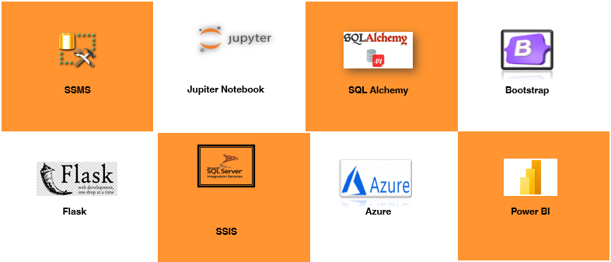
Project Overview
Frameworks/Tools
Data Flow
Collection : Data is sourced from Kaggle CSV files.
Storage : Excel files are ingested into SQL Server tables
Analysis and Access : SQL queries and Python scripts are used for exploratory and in-depth analysis.
Programming Languages
Essential for managing and querying the relational database in SQL Server Management Studio (SSMS).
Used for data analysis, machine learning models, and backend development within the Flask application.
Powers interactive elements and dynamic features in the frontend, including data visualizations and form validations.

Slide 4
Project Milestones
Business Knowledge &
Creation
Data Base
Microsoft Azure
Data warehouse &
(ETL)
Python & ML Models
Power BI (Dashboard)
Flask APP
Creation / Architecture
The project began by setting up the Global Gourmet database, created using SQL Server and Windows authentication. The schema consists of the following tables:
Employees - Categories – Customers – Shippers – Suppliers – Orders – Products - Order Details - Territories - Employee Territories – Regions
Our SQL Server Management Studio (SSMS) database uses a relational architecture to organize structured data with defined relationships, ensuring data integrity and efficient querying for analytics and reporting.

Slide 5

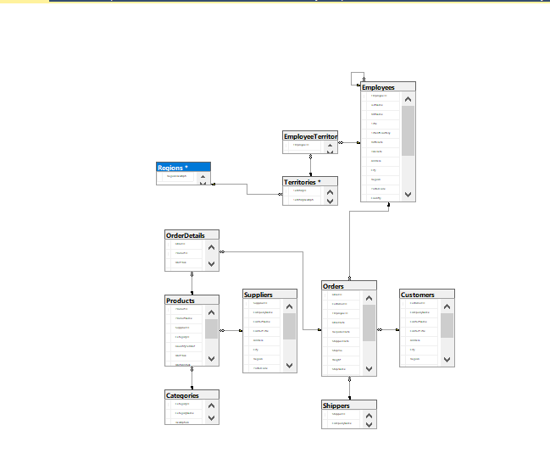
The project began by setting up the Global Gourmet database, created using SSMS
SQL Phases
Stored Procedure : Get Suppliers for a Product
Triggers : trigger for Preventing Deletion of Managers: This trigger prevents the deletion of employees who are manager
Creation Data Base
Database Architecture
Stored Procedure
Triggers

Slide 6
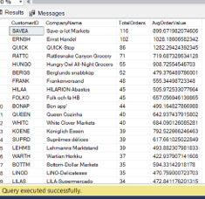
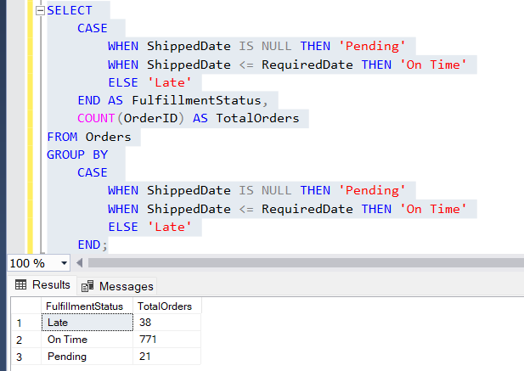
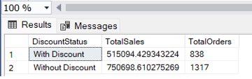
Order Fulfillment Status Analysis: Tracking Pending, On Time, and Late Orders
SQL Phases
Sales Analysis by Discount Status
Creation Data Base
Analysis of Customer Behavior by Number of Orders and Average Order Value
Database Architecture
Stored Procedure
Triggers
Order Analysis
Sales Analysis
Customer Behavior Analysis

Slide 7
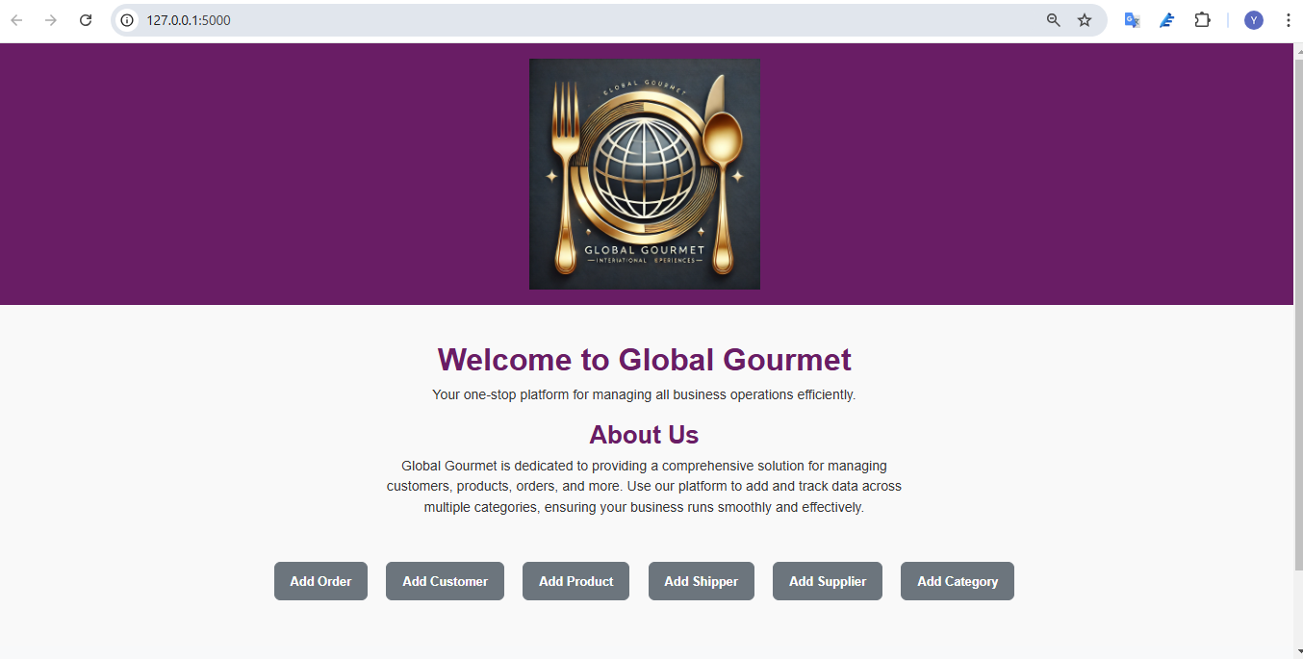
Flask APP
Flask Phases
The Flask app for Global Gourmet is a web application connected to a SQL Server database, allowing for order tracking and customer management across multiple structured pages. It includes features like data entry forms and organized tables for categories, customers, products, and other essential business entities.
Set Up Environment
Database Setup
Define Models
Create Routes
Build HTML Templates
Add Forms and Validation
Run and Test App

Slide 8

Flask APP

Slide 9
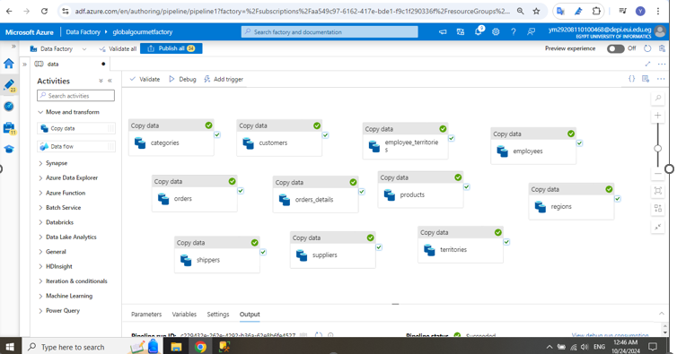

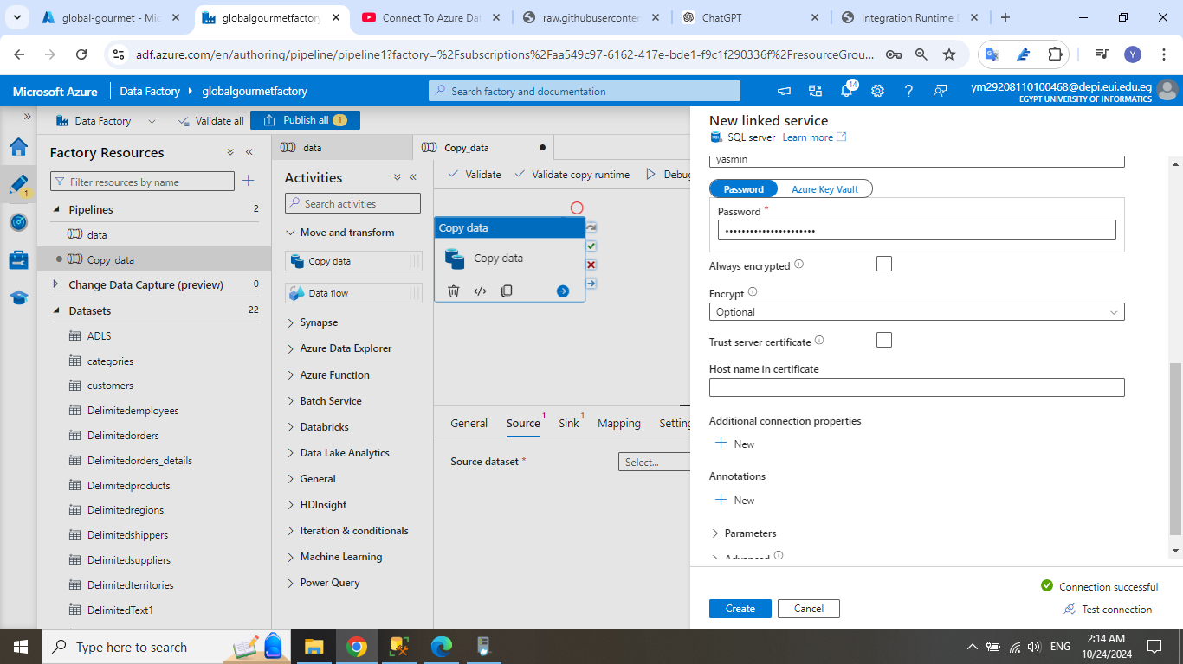
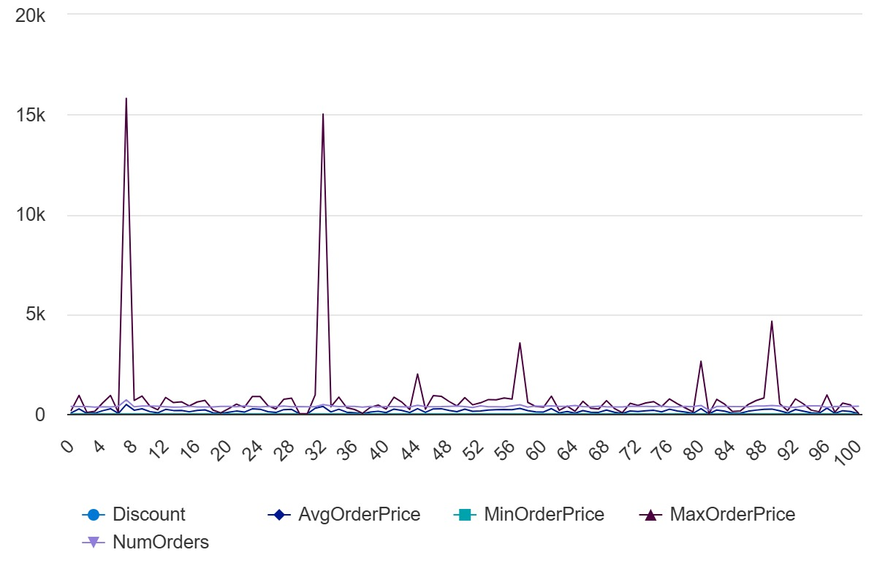
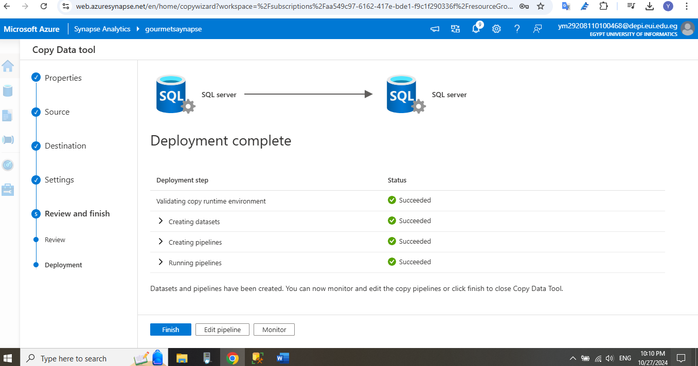
Azure Phases
Connect SSMS to Azure
Create Azure Data Factory
Store the Database Tables into ADL GEN2
Open Azure Synapse Analysis
Create pipeline to add copy of the data
Integration for Scalable Data Processing
End-to-End Data Flow for Analytics and Insights

Slide 10
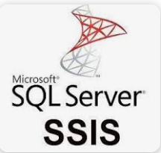
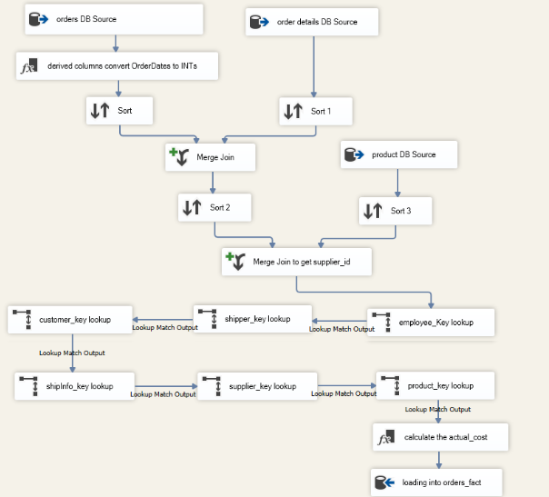
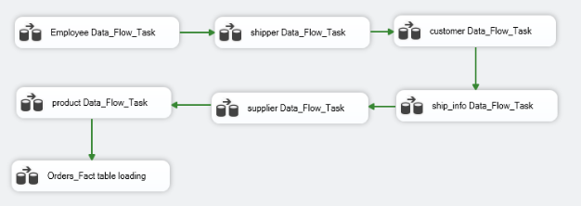
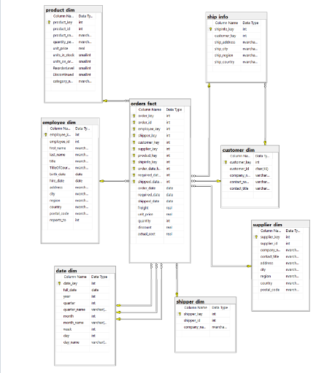
Star Schema Design for Global Gourmet Database
SSIS Data Flow Tasks for ETL Process Visualizes SSIS data flow tasks for loading dimension tables and the fact table, ensuring clean and organized data for reporting.
Data warehouse Phases
Detailed ETL Process with Transformations in SSISDepicts data transformations in SSIS, merging and matching data across sources before loading it into the Orders Fact Table.
Building a Star Schema Data Warehouse with SSIS
Connect SSMS and SSIS
Data Extraction and Cleansing with SSIS
Loading Dimension Tables for Contextual Insights
Using Lookup Transformations for Data Consistency in SSIS
Calculation and Enrichment of Cost Metrics
Final Data Load into SSMS for Reporting and Analysis

Slide 11
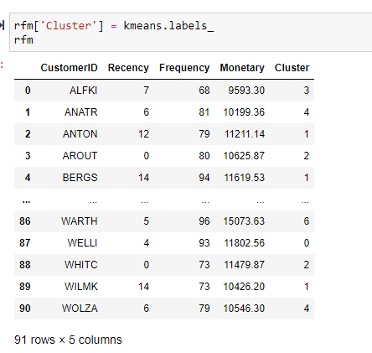
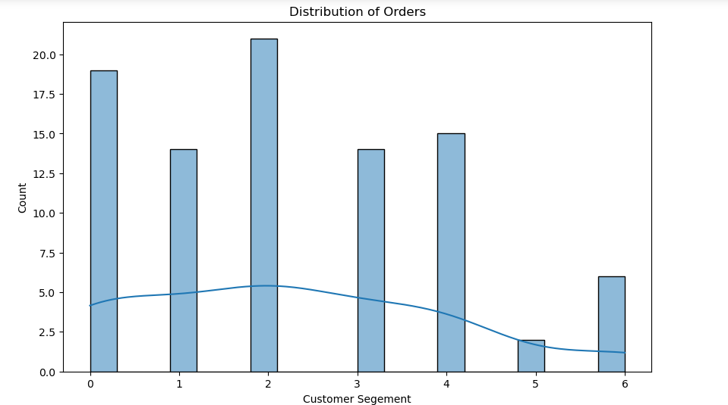
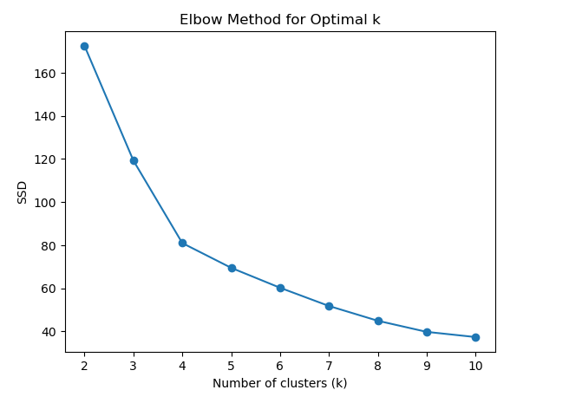
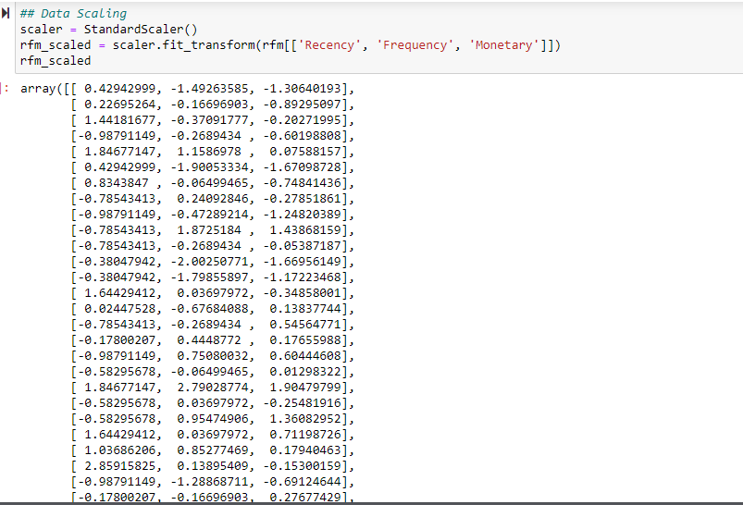
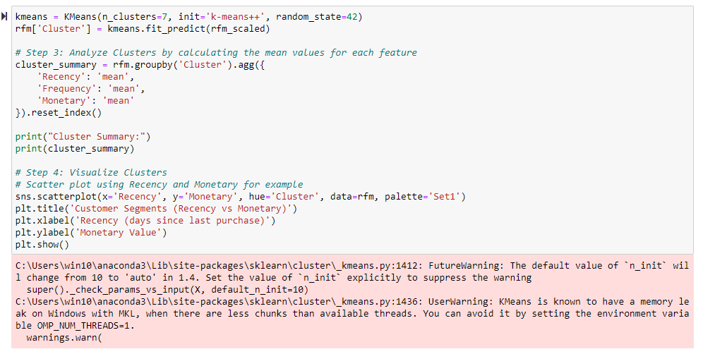
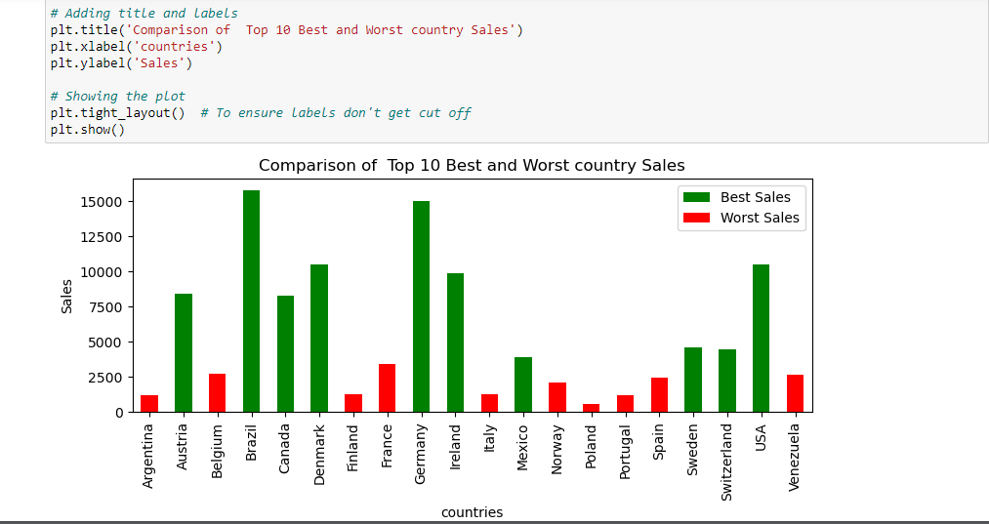
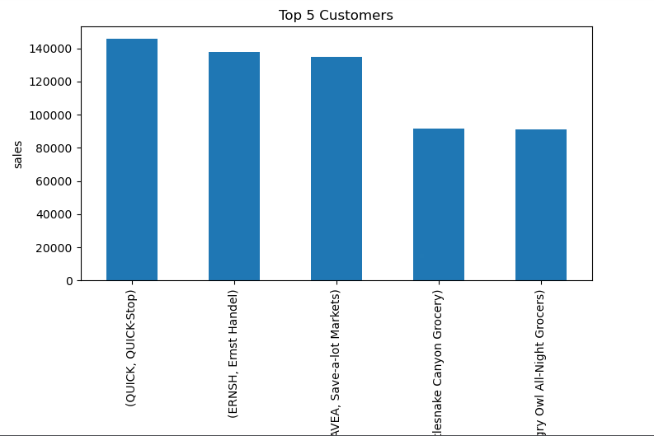
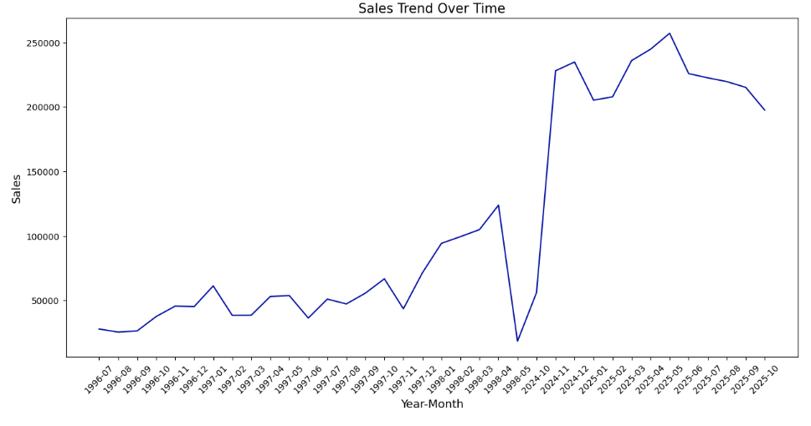
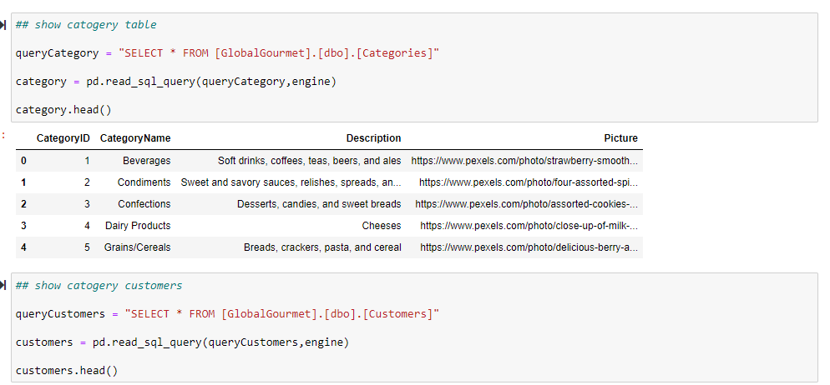
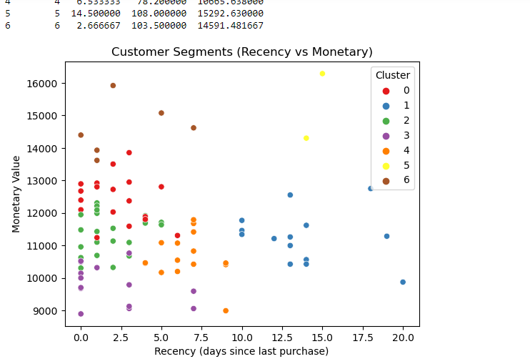
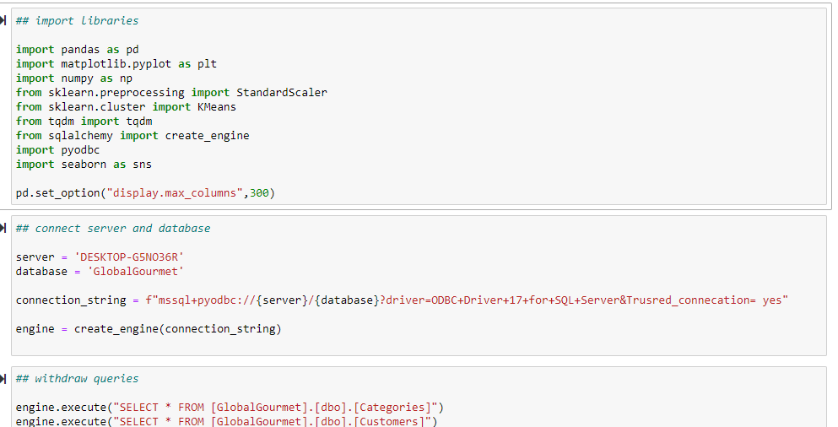
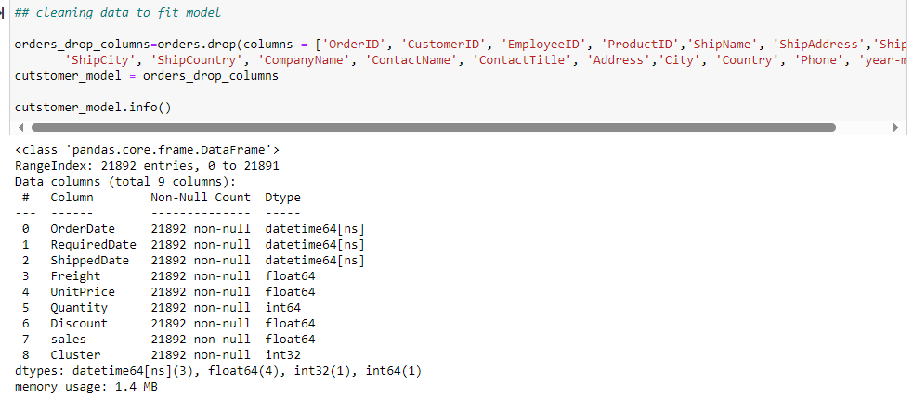
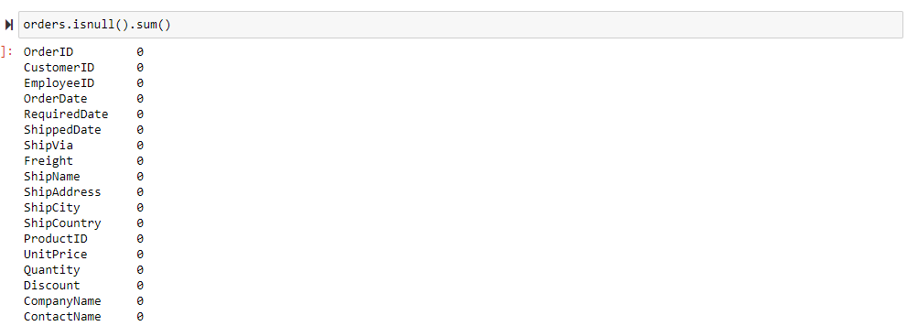
Scope Of Work
Python Phases
Data cleaning and machine learning project in Python involved preprocessing a classic sales and inventory dataset by handling missing values, standardizing formats, and removing duplicates. After cleaning, feature engineering was applied to enhance predictive insights. A machine learning model was then developed to forecast key metrics, providing valuable insights for sales and inventory optimization
Import libraries
Create engine (connection)
Reading Data
Data Reshaping
Cleaning Data
Feature extraction
Feature selection
Visualizations
ML Models
Evaluation

Slide 12
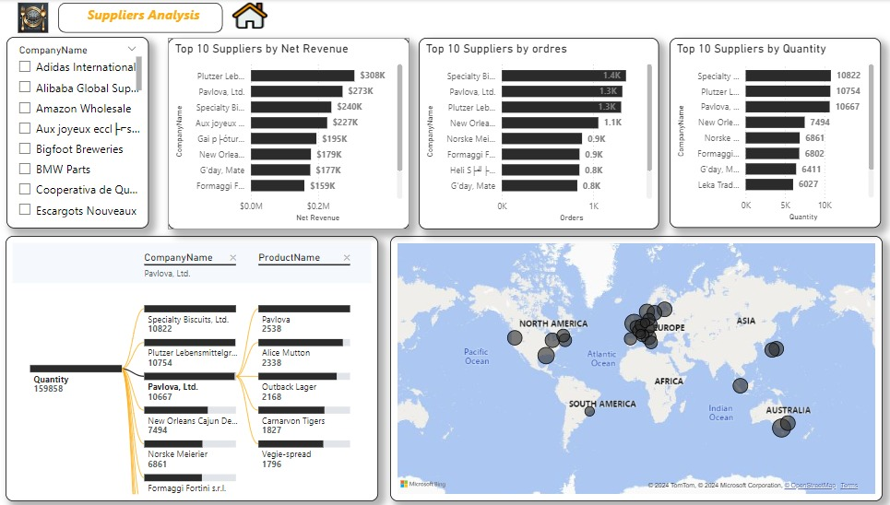
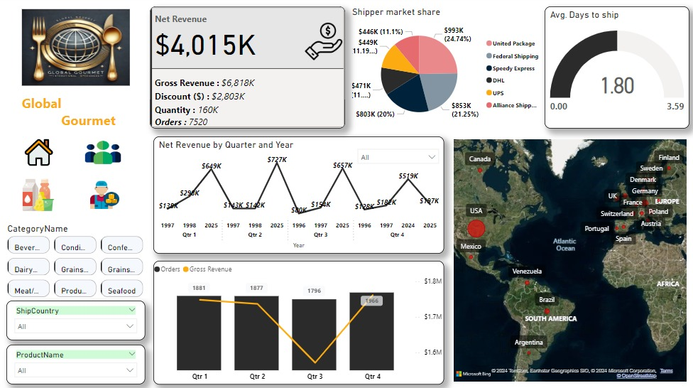
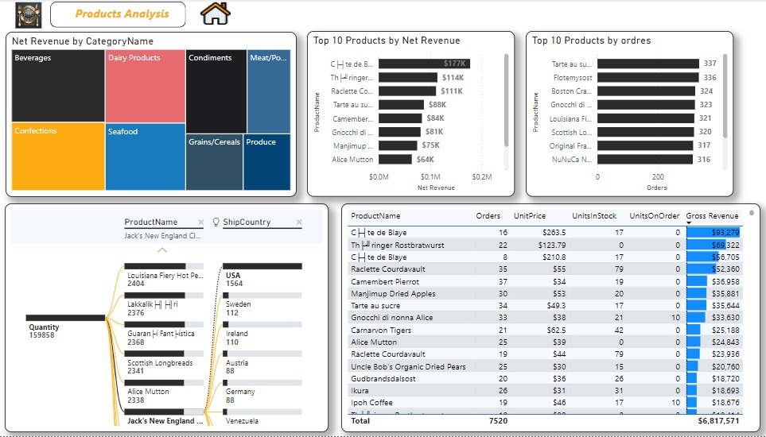
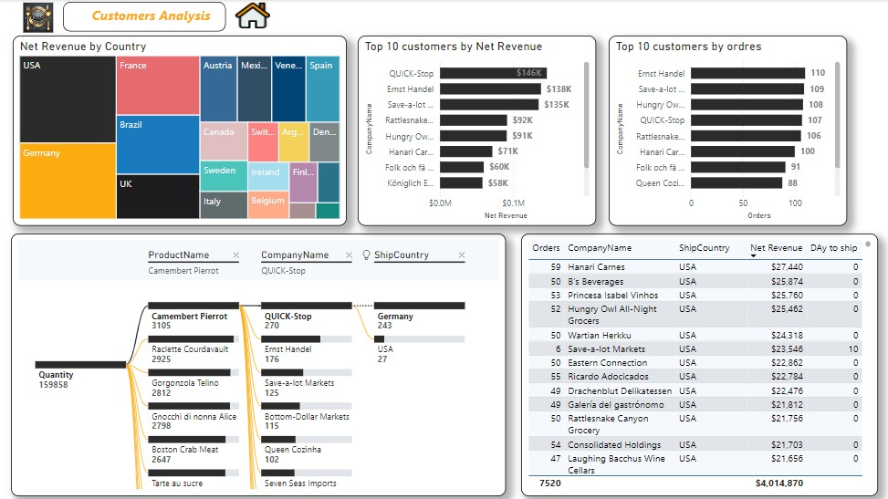
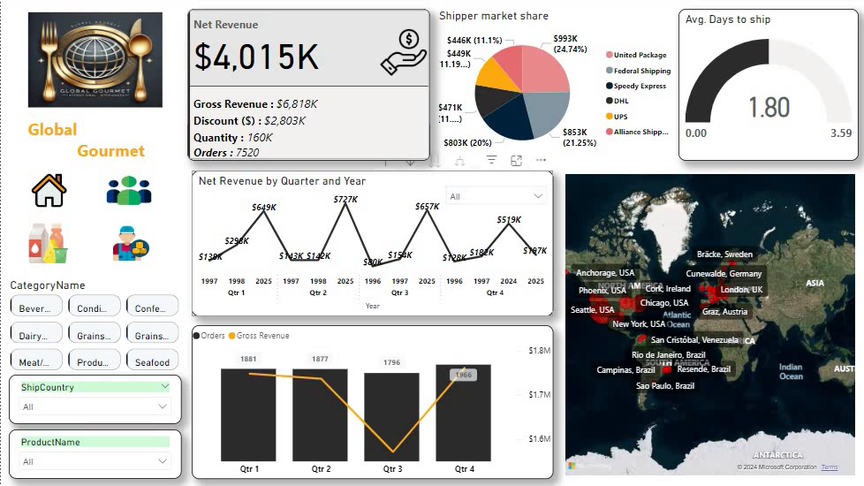
Scope Of Work
Power BI Phases
Power BI enables streamlined data analysis and visualization. This integration facilitates data-driven insights, allowing users to create dynamic reports and dashboards that support decision-making in areas like sales, inventory, and customer management.
Connection Data Base
Load Data
Data Transformation
Create Date Table
Create Relationships
Build Visualizations
Create dashboards
Department-wise analysis
Create Roles
Implementation to service

Slide 13

Conclusion
The project provides valuable insights into business operations, enabling a comprehensive analysis across departments. Key focus areas included data cleaning for accuracy, establishing relationships in the database for a structured view, and feature engineering to enhance predictive capabilities. The model developed from this data helps forecast critical metrics, supporting better decision-making in areas like sales, inventory management, and customer trends.

Slide 14

THANK YOU
We’d be happy to hear any feedback or suggestions you might have!

